Slide 1

AT US Category Preference

Slide 2

Background and Approach:
AT has 19 categories for Women’s division.
Category Preference is used for ranking those categories for a masterkey in which there is some engagement in terms of last 12 months of transactions or last 3 months of browse.
Algorithm used is LambdaMart and we maximize a metric called ‘normalized discounted cumulative gain (ndcg)’
100000 masterkeys with categories in which they had shown some engagemnet in 2015 were used to train the model to predict what they would buy in each of these categories in Jan-Mar,2016
Variables used were :transactions in the last 12 months,transactions in the same period last year,browse history in last 3 months.
*LambdaMart in detail in appendix

Slide 3
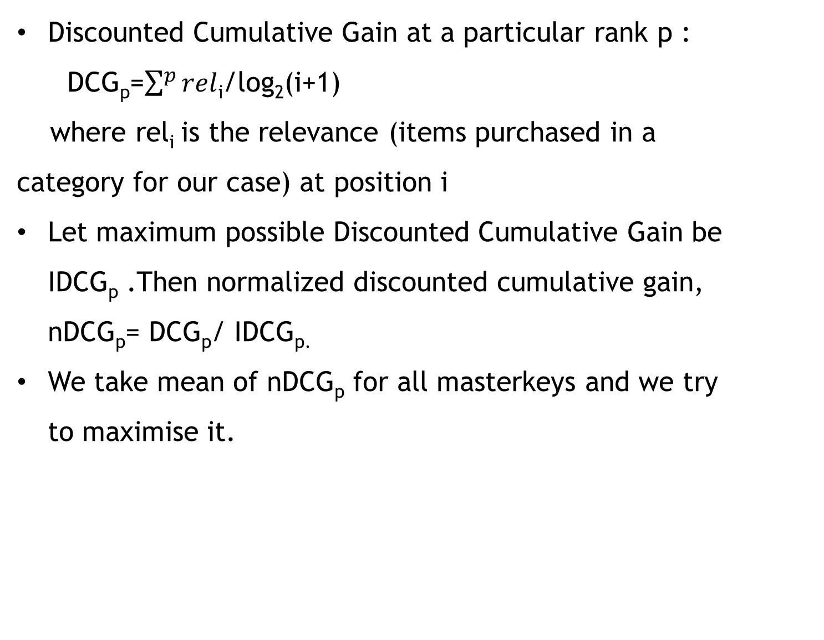
Normalized Discounted Cumulative Gain
Discounted Cumulative Gain at a particular rank p :
DCG_{p}=$\sum^{p}{rel}$_{i}/log₂(i+1)
where rel_{i} is the relevance (items purchased in a category for our case) at position i
Let maximum possible Discounted Cumulative Gain be IDCG_{p} .Then normalized discounted cumulative gain, nDCG_{p}= DCG_{p}/ IDCG_{p.}
We take mean of nDCG_{p} for all masterkeys and we try to maximise it.

Slide 4
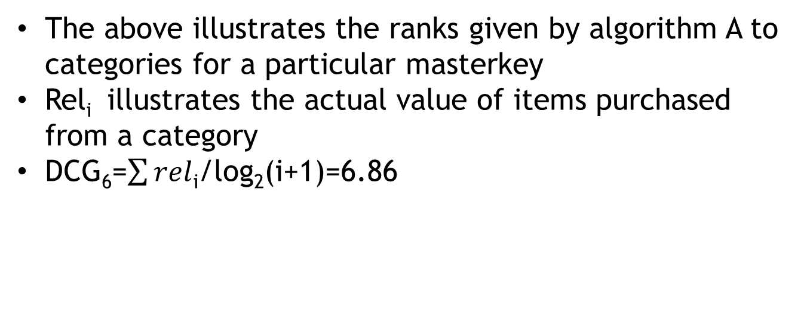
Demonstration of NDCG
Rank given by algorithm A (i) | rel_{i} | log₂(i+1) | rel_{i/}log₂(i+1)
1 | 3 | 1 | 3
2 | 2 | 1.58 | 1.26
3 | 3 | 2 | 1.5
4 | 0 | 2.32 | 0
5 | 1 | 2.58 | 0.39
6 | 2 | 2.80 | 0.71
The above illustrates the ranks given by algorithm A to categories for a particular masterkey
Rel_{i} illustrates the actual value of items purchased from a category
DCG₆=$\sum{rel}$_{i}/log₂(i+1)=6.86

Slide 5
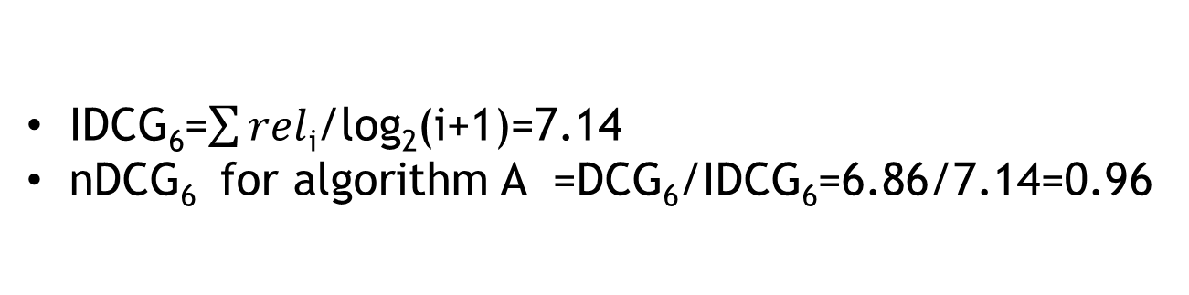
Rank by Ideal algorithm (i) | rel_{i} | log₂(i+1) | rel_{i/}log₂(i+1)
1 | 3 | 1 | 3
2 | 3 | 1.58 | 1.89
3 | 2 | 2 | 1
4 | 2 | 2.32 | 0.86
5 | 1 | 2.58 | 0.39
6 | 0 | 2.80 | 0
IDCG₆=$\sum{rel}$_{i}/log₂(i+1)=7.14
nDCG₆ for algorithm A =DCG₆/IDCG₆=6.86/7.14=0.96

Slide 6
1000 masterkeys were randomly selected from the training dataset and ndcg was computed for them by taking the score of the model for ranking
 | NDCG
Rank upto 1 | 0.274
Rank upto 2 | 0.398
Rank upto 3 | 0.487
Rank upto 19 | 0.655

Slide 7
Business Logic:We predict that what a particular masterkey for a particular category bought in the same period last year,he will buy the same in the same period this year.
On a testing dataset of 1000 masterkeys ,we compared the ndcg of the lambdamart model and business logic.
 | LambdaMart | Same period Business Logic | Last year Business Logic | Recently clicked Business Logic
Rank upto 1 | 0.326 | 0.229 | 0.229 | 0.229
Rank upto 3 | 0.489 | 0.44 | 0.44 | 0.44
Rank upto 19 | 0.664 | 0.622 | 0.622 | 0.622

Slide 8
 | LambdaMart | Same period Business Logic | Last year Business Logic | Recently clicked Business Logic
Sum to top 1 | 0.534 | 0.429 | 0.506 | 0.476
Sum to top 3 | 0.775 | 0.936 | 0.812 | 0.825
Sum to top 10 | 0.993 | 1 | 0.997 | 0.994

Slide 9
 | LambdaMart | Same period Business Logic | Last year Business Logic | Recently clicked Business Logic
Sum to top 1 | 0.593 | 0.397 | 0.552 | 0.448
Sum to top 3
Sum to top 10

Slide 10
Appendix

Slide 11
LambdaMart
We make the basemodel for {x_{i,}y_{i}} by using least square regression tree which gives scores s_{i} .
Utility function C is
∑_{{i,j}}|∆z_{ij}|log(1+exp^{-σ(s}_{i}-^{s}_{j}⁾)
where ∆z_{ij} is the difference in ndcg when the ranks of i and j are interchanged.
Set number of trees N,number of training samples m,number of leaves per tree L,learning rate η

Slide 12
For i=0 to m do
F₀(x_{i})=BaseModel(x_{i})
End for
For k=1 to N do
for i=0 to m do
y_{i}=∂C/∂F_{k-1}(x_{i})
w_{i=}∂y_{i} /∂F_{k-1}(x_{i})
end for
{R_{lk}} //Create L leaf tree on {x_{i,}y_{i}}
ϒ_{lk}=(∑_{xiϵRlk} y_{i})/ (∑_{xiϵRlk} w_{i})
F_{k}(x_{i})= F_{k-1}(x_{i}) + η ∑_{l} ϒ_{lk*}I(x_{i}ϵR_{lk})
End for

